Slide 1
What are the Tactical Applications of Topology in the United States Military?
By Amber Bustard and Casey Feinstein

Slide 2
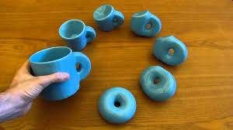
What is Topology?
Topology is the mathematical study of shapes and topological spaces. It is an area concerned with the properties of spaces including stretching and bending without tearing or gluing.

Slide 3
Connections to our STEM Class
Topology isn’t only found in the making of letters using another letter, but Topology can be found in real life, such as in the military…
Similar to the letters, the connections between militia vehicles and bases cannot be broken (at least two devices have to be connected to each other at all times) to form new data from the transmitter to the receiver
If connection is broken, communication is lost which could lead to catastrophes such as:
Hacking/intercepting information from the enemy
Friendly fire
Inability to receive orders
Ending up in the wrong location

Slide 4
What are the different kinds of topology?
Network Topology
Point to point topology
BUS topology
Star topology
Spring topology
Mesh topology
Tree topology

Slide 5
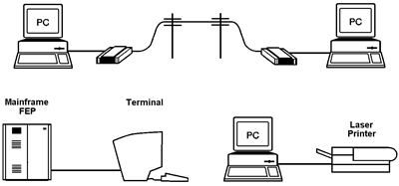
Point-to-Point Topology
Point-to-point topology connects two nodes (points) together.
Ex: 2 computers communicating by modems; a printer and a computer being connected by modems; tin can telephone

Slide 6
BUS Topology
Bus Topology connects a;; computers and devices (nodes) to some cable or BUS (half-duplex link).
Consists of a main run of cable with a terminator attached at each end
Ex: When computers and peripherals in the network are connected to a mutual cable

Slide 7
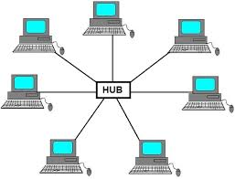
Star Topology
In local networks, Star Topology connects each network host to a central node (often called a hub or switch)
The networks are often connected in a formation of a star shape, which is where this topology receives it’s name
Ex: Home networks, devices connect to the hub with “Unshielded Twisted Pair (UTP) Ethernet

Slide 8
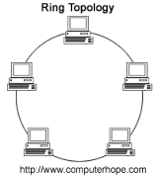
Ring Topology
Ring Topology is set up in a circular formation where the data transmitted travels around the ring in one direction as each node is connected to exactly two other nodes.
Each node has acts as a receiver and a transmitter for incoming and outgoing data
Ex: Used in LAN (local area network) and WAN (wide area network) set ups

Slide 9
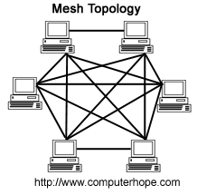
Mesh Topology
In Mesh topology each node relays data for the network where they then distribute this data throughout the network
Most commonly used topology in the military

Slide 10
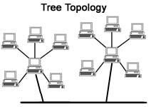
Tree Topology
In tree topology the central root node (the top level ofthe hierarchy) is connected to one or more other nodes that are one level lower in the hierarchy (i.e., the second level) with a point-to-point link between each of the second level nodes and the top level central rootnode
Known as a combination of two or more star networks connected together

Slide 11
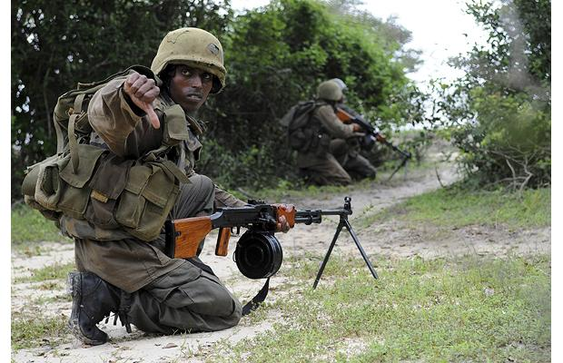
Advantages and Disadvantages of using these Topologies…

Slide 12
Advantages of the 4 Most Common Topologies
BUS TOPOLOGY
Easy to connect a computer or peripheral
Requires less cables than any other topologies.
Doesn’t requires any specialized network equipment.
RING TOPOLOGY
Cable faults are easily located making trouble shooting easier
Ring networks are moderately easily to install.
MESH TOPOLOGY
Provides redundant path between the devices
Network can be expanded without any inconvenience to current user.17.
STAR TOPOLOGY
Easy to install and wire.
Easy to detect faults and remove parts.

Slide 13
Disadvantages of the 4 Most Common Topologies
BUS TOPOLOGY
Difficult to troubleshoot
Network is disrupted when more computers are added to it.
A break in the cable will prevent all systems from accessing the network.
RING TOPOLOGY
Expansion to the network can cause network disruption
A single break in the cable can disrupt the entire network
MESH TOPOLOGY
Requires more cables than any other topology (Too bad the military uses wireless...
STAR TOPOLOGY
Requires more cable length.
If the hub or concentrator fails nodes attached are disabled

Slide 14
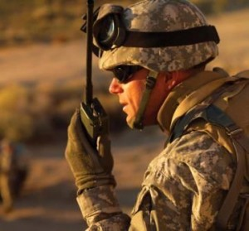
So… How does any of this relate to the military???
One of the keys to the success in our United States Military is communication…
How can one complete their individual mission while staying in contact with the rest of the group?
Mobile Mesh Network Topology
Allows each radio to talk to any other radio station directly or through each other

Slide 15
Mobile Mesh Networks
Due to the terrain being unpredictable an algorithm cannot be used to determine the best route to transmit the data among the soldiers so a “Relay” System is used
The “Relay” System is when one device/person is chosen to become the one to receive the voice transmission from all senders, record it manually and then retransmits data to receiver
In order to accommodate the constant communications and data links
The wireless data network was developed which exhibits the characteristics of a true mesh topology
Each device =node (transmits own data and forwards traffic unrelated to its own functions)
Optimizes processes such as
movement of supplies to the battlefield,
Reports casualties back to ambulance exchange points

Slide 16
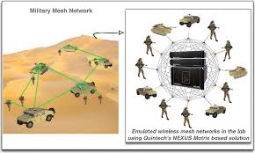

Slide 17
Mobile Mesh Network Video

Slide 18
Real World Applications
The Army’s Combat Service Support Automated Information Systems Interface (CAISI)
Uses a mesh network that integrates key logistical systems such as the Unit Level Logistics System-Ground (ULLS-G) and the Medical Communications for Combat Casualty Care (MC4
Serves as an actual framework of the mesh network and allows these systems to communicate data
Allows warfighters to focus and accomplish their mission rather than establishing communications

Slide 19
Thank for your attention, and to these awesome sources … Oohyah!
http://www.google.com/url?sa=t&rct=j&q=&esrc=s&source=web&cd=7&cad=rja&uact=8&ved=0ahUKEwjc4o2Mi67QAhVC22MKHXVZDTEQFghGMAY&url=http%3A%2F%2Fwww.slideshare.net%2Fknx007%2Fnetwork-topology-and-devices&usg=AFQjCNFw7NBEm7936NUfvV7iWOWmRga3Dw&sig2=YaR_88308ypS1j7AnfWYSA
http://www.allaboutcircuits.com/news/military-tactics-and-the-future-of-mobile-communications
http://www.quintechelectronics.com/solutions/government-military/wireless-mesh-network/
http://www.conceptdraw.com/diagram/example-of-bus-topology-in-real-life
http://searchnetworking.techtarget.com/definition/tree-network

